Slide 1
Assignment -1

Slide 2
Journey of Automotive
1st Steam Powered Vehicle (TOY CAR) by Ferdinand Verbiest in 1672.
Steam Engine (Vehicle) by Nicolas Cugnot in 1771
Steam Engine (Carriage) by William Murdoch in 1784.
High Pressure Steam Engine (Full-sized vehicle) by Richard Trevithick in 1801.
IC Engine using Hydrogen and Oxygen Mixture by Francois Isaac De Rivaz in 1826
Toy Car (Electric) by Anyos Zedlik in 1826
Oil-fired steam car by Josef Bozek in 1816.
1st IC Engine (Vehicle) by Isaac de Revaz in 1806
Electric Tram introduced in LONDON in 1865
High –wheeled carriage with bracing Two –cylinder steam engine by Henry Seth Taylor in 1867.
1st automobile in US (Steam-powered Vehicle) by Dr J.W. Carhart in 1871.
1st Self-propelled steam road vehicle by Amebdee Bollee in 1873.

Slide 3
1st Petrol Car built by Siegfried Marcus in 1875
1st Low-voltage ignition system by Siegfried Marcus in 1883
One-cylinder IC Engine using COAL GAS by Jean J. Lenoir in 1884
1st Automobile IC Engine Vehicle by Carl Benz in 1885
1st Electric Vehicle in production by Thomas Parker in 1886 (England)
1st Single-cylinder gasoline car built by George Foote Foss in 1896
1st Four-wheeled petrol-driven automobile by Frederick Bremer in 1892
1st Electric Vehicle by William Morrison in 1890 (USA)
1st True Electric Car by Andreas Flocken in 1888 (German)
1st Electric Starter in between 1895 & 1898
1st Single-cylinder gasoline car built by George Foote Foss in 1896
Electric Vehicle in 1906 with 100 miles of range
1st NiMH & Lion battery electric car by 1997 Toyota & Nissan in 1997.

Slide 4
Milestones in Automotive Journey
In 1828, the Hungarian priest and physicist Anyos Jedlik invented an early type of ELECTRIC MOTOR.
B) In 1906, electric vehicles are very advance and had a range of 100 miles with the TOP SPEED
of 45~50 kmph.
C) Electric vehicles dominated by Gasoline cars by Assembly line production, using self start motor,
Cost reduction year on year, non reliable, easy start, no charging time, easily carry extra fuel and
Oil lobby.
D) New ERA of EV start in 2006 in Santa Monica Auto expo where TESLA introduces “TESLA
ROADSTER” And In 2010 Nissan introduces “Leaf” first affordable 5 door hatchback EV”.

Slide 5
Introduction to Hybrid Electric Vehicles
Types of EV-
HEV- Hybrid
BEV- Battery
PCEV- Fuel cell
Hybrid Architecture
Series
Parallel
Series-Parallel
Degree of Hybridisation
HEV (Battery)
Micro
Mild
Fuel

Slide 6
Hybrid Electric Vehicle- Series
Disadvantages:
1) Larger, more complicated battery and motor to meet its power needs.
2) Addition of generator make it costlier.
Advantages:
Engine operates at its maximum efficiency.
Capable of attaining zero emission.
Gasoline Tank
IC Engine
Generator
Power converter
Battery Pack
Transmission
Motor
Motor Drive
Power Converter

Slide 7
Hybrid Electric Vehicle- Parallel (HEV)
Gasoline Tank
IC Engine
Transmission
Electric Motor / Generator
Motor Drive
Disadvantages:
Extra cost.
Extra Weight
Advantages:
Reduced Traction motor size.
No need for a generator
Power converter
Battery Pack

Slide 8
Hybrid Electric Vehicle- Series-Parallel
Disadvantages:
Costly.
Requires a generator, a large battery pack & more computing power to control two system.
Advantages:
IC Engine is also used to charge the battery.
Capable of proving continuous high output.
Gasoline Tank
IC Engine
Power Split
Generator
Power converter
Transmission
Battery Bank
Motor
Motor Drive
Power Converter

Slide 9
Hybrid Electric Vehicle- Plug-in (PHEV)
Disadvantages:
Relatively expensive.
Complex to maintain.
Advantages:
Zero emission on battery driving.
Easy to drive.
Gasoline Tank
IC Engine
Transmission
Electric Motor / Generator
Motor Drive
Power converter
Onboard Charger
Battery Pack

Slide 10
Hybrid Electric Vehicle- Fuel Cell (FCEV)
Disadvantages:
Fuel cell durability & reliability
Expensive.
Advantages:
Less Greenhouse Gas Emissions
Reduced Oil Dependence.
H2 Tank
Fuel Cell Stock
Power converter
Battery Bank
Power converter
Motor Drive
Electric Motor / Generator
Transmission

Slide 11
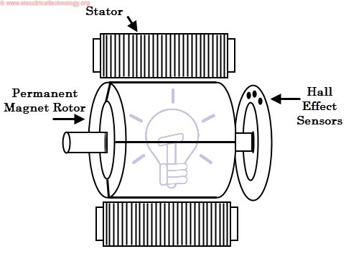
Construction of BLDC Motor
The construction of this motor has many similarities of three phase induction motors as well as conventional DC motors. This motor has stator and rotor parts like all other motors

Slide 12
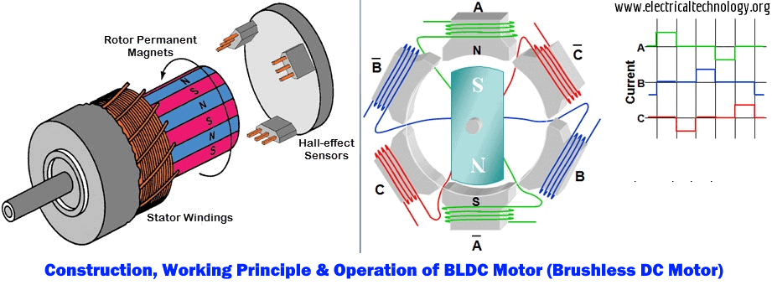
Working Principle & Operation of BLDC Motor
BLDC motor works on the principle similar to that of a conventional DC motor, i.e., the Lorentz force law which state the whenever a current carrying conductor placed in a magnetic field it experiences a force. As a consequence of reaction force, the magnet will experience an equal and opposite force. In case BLDC motor, the current carrying conductor is stationary while the permanent magnet moves.

Slide 13
Battery Pack Composition
Currently we are using Li-ion cells.
NMC622
N= 60%
M=30%
C=20%
Where
N= Nickle
M=Magnese
C=Cobalt
Advantage:
Energy density
Charging and discharging rate.
Disadvantage:
Less charging stations.
Higher initial cost.
Limited driving range.
Explosive.

